Slide 1
Chrome Dev Tools
Introduction to JS Debugging Techniques using Chrome Developer Tools
Mihai Sitaru
Iasi – Conf 205, July 16, 2019
Notes:
The Chrome DevTools are a set of web authoring tools built into chrome.

Slide 2
Agenda
01
05
Intro
Console API
02
06
A tour of the developer tools
Basic JavaScript debugging
03
07
GUI style editors
Call stack - "the JS time machine“, Watch expression
04
08
Snippets and alternate ways to understand your changes
Network, page speed & security
Notes:
incepem cu un mic intro (memes)
vom face un tur al celor mai importante tab-uri
incepand cu punctul 3 vom parcurge fiecare tab in browser

Slide 3
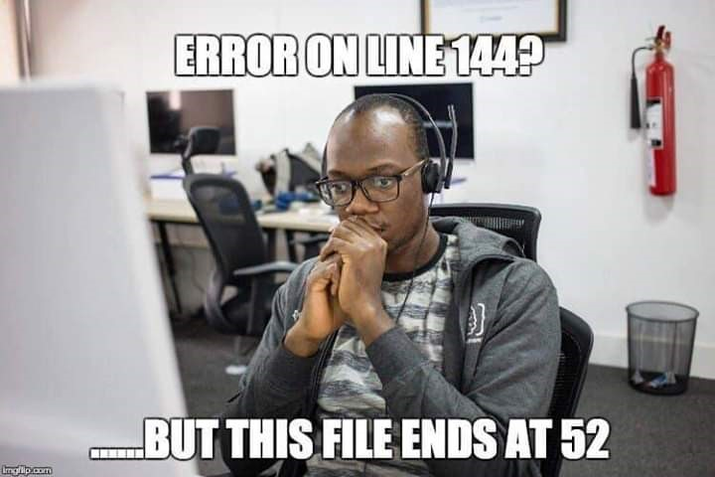
Notes:
Acest lucru este posibil datorita browserului IE in unele cazuri, dar de obicei este vorba despre cod generat dinamic si foarte rar este vorba de cod introdus direct in body cu ajutorul tab-urilor <script></script>.

Slide 4
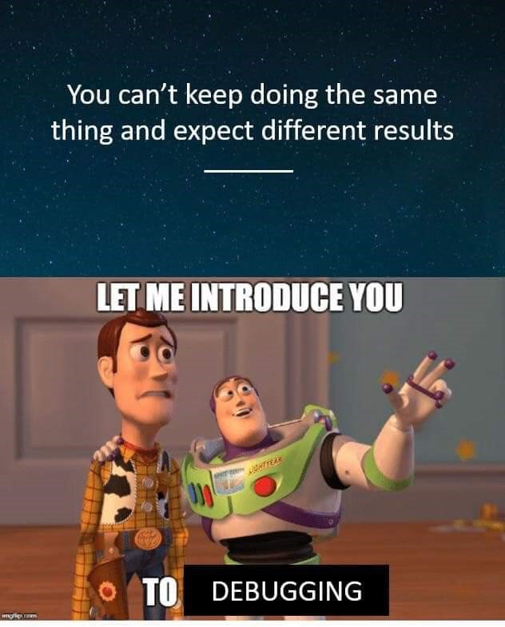
Notes:
No comments.

Slide 5
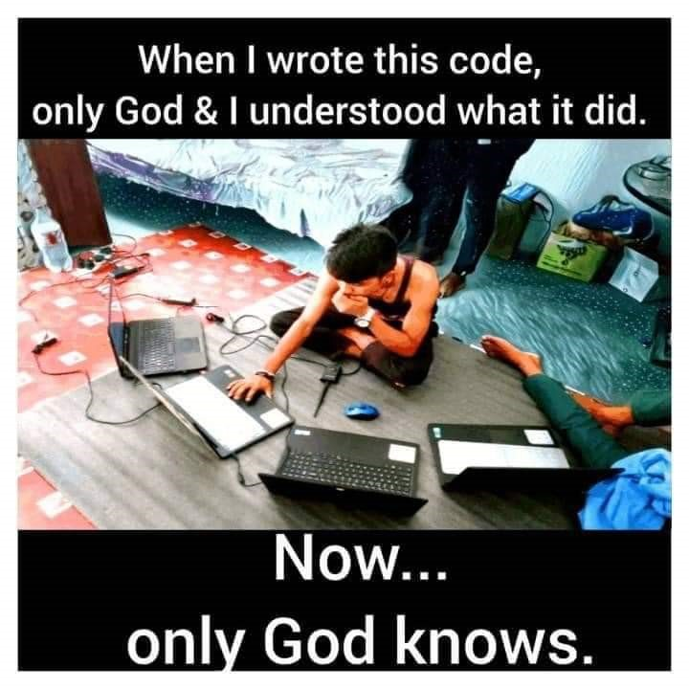
Notes:
Exista situatii in care solutiile create au fost indelung gandite si imbunatatite, incat daca nu se adauga comentarii ajutatoare, cel mai probabil tu din viitor sau un coleg/a va trebui mai intai sa inteleaga solutia ca ulterior sa o poata modifica sau fixa, dupa caz. De aceea se spune ca de cele mai multe ori developerii citesc mai mult cod decat scriu efectiv.

Slide 6
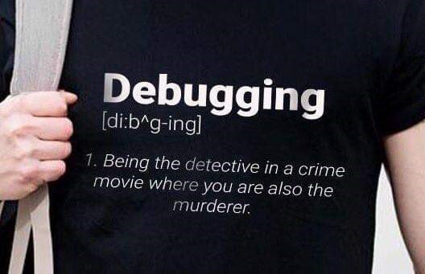
Notes:
Deseori la implementarea unei noi functionalitati ai nevoie de debugging daca nu se intampla ceea ce ai sperat.

Slide 7
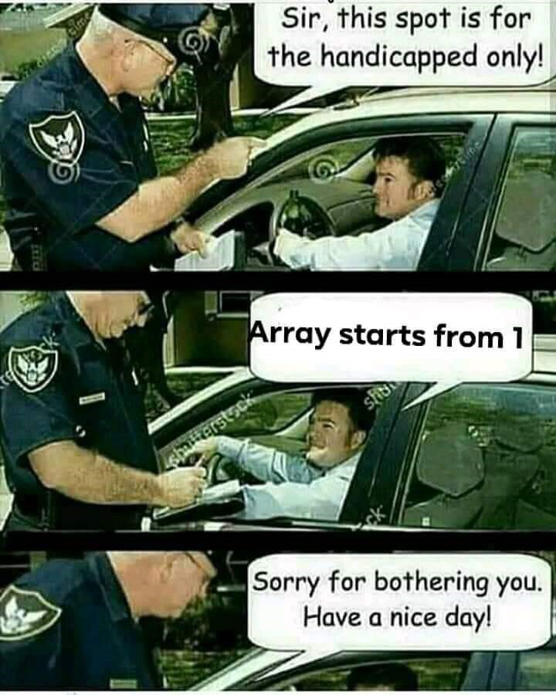
Notes:
Bazele JS sunt lucruri care, daca nu sunt deja foarte bine stiute, vor putea da batai de cap pe viitor.
Nicio grija, Google si Stackoverflow sunt mereu prietenii vostri ☺.

Slide 8
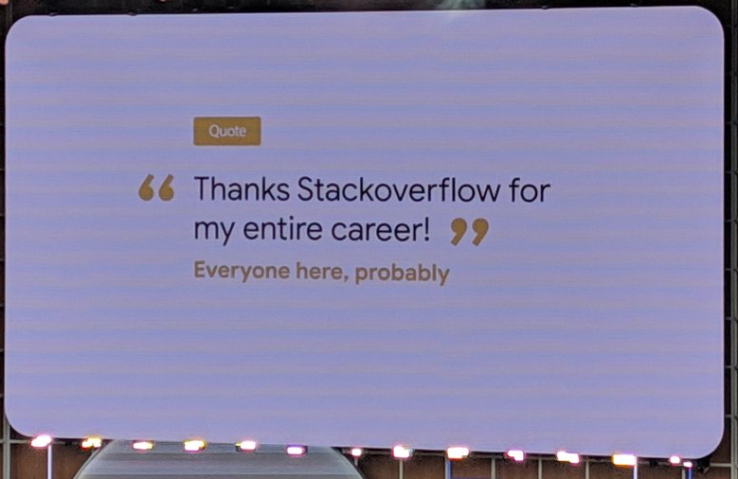

Slide 9
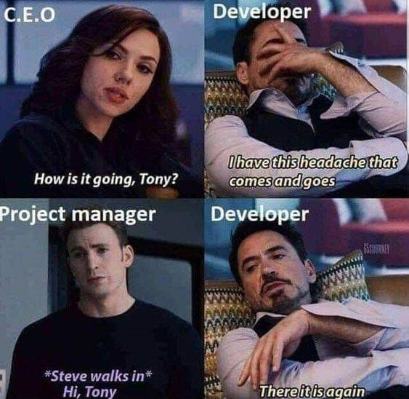
Notes:
No comments.

Slide 10
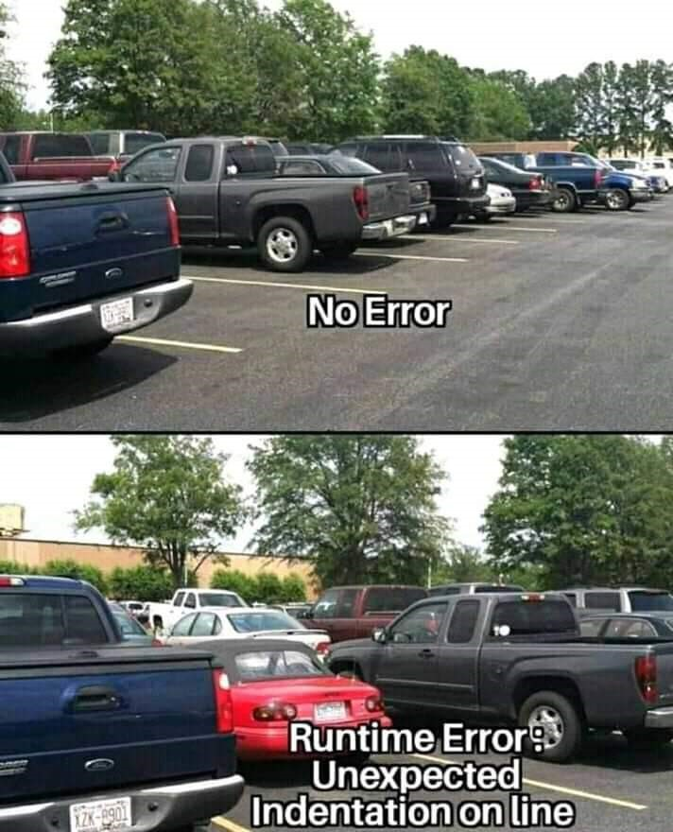
Notes:
Runtime error refers to an error that takes place while executing a program, occurs only during the execution of the program.
Runtime errors imply bugs in the program or issues that the developers had expected but were unable to correct.
For example, insufficient memory can often trigger a runtime error.

Slide 11
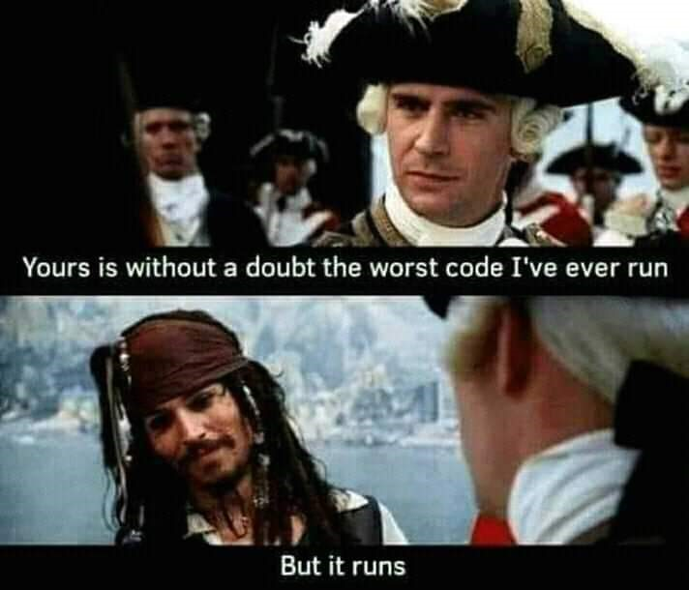
Notes:
Deci poate mereu fi imbunatatit, atata timp cat functioneaza.

Slide 12
Elements - GUI style editors
Navigating the DOM
Searching the DOM
Editing the DOM – toggle classes, add/edit attributes, etc.
Locating and editing the styles
Responsive breakpoints, emulate devices

Slide 13
Console - API
document.querySelector(‘p’),
document.querySelectorAll(‘p’)
$0 - $4 - $_
write JS, lodash/underscore, momentJs, etc.
Notes:
Lodash: _.isBoolean(true);

Slide 14
Sources
Find and open page files
Pretty print
Breakpoints - Basic JavaScript debugging
Call stack - "the JS time machine“, Watch expression
Snippets and alternate ways to understand your changes
Notes:
Lodash: _.isBoolean(true);

Slide 15
Network
Waterfall view – Capture screenshots
Table view
Sorting/filtering table view
Detailed view
Network throttling – page speed

Slide 16
application
Clear cookies
View local storage
More tools – Network conditions - User agent spoofing, Disable cache

Slide 17
Audits
Audits helps you identify and fix common problems that affect your site's performance, accessibility, and user experience

Slide 18
Settings
Debugger - Disable JavaScript
Theme
and many more

Slide 19
Resources
Official Chrome DevTools Website
Chrome Snippets
Chrome Tips
25 Tips and Tricks
Chrome Command Line API

Slide 20
Q & A
Thank you!
IASI, July 16, 2019
m.sitaru@levi9.com

